Slide 1
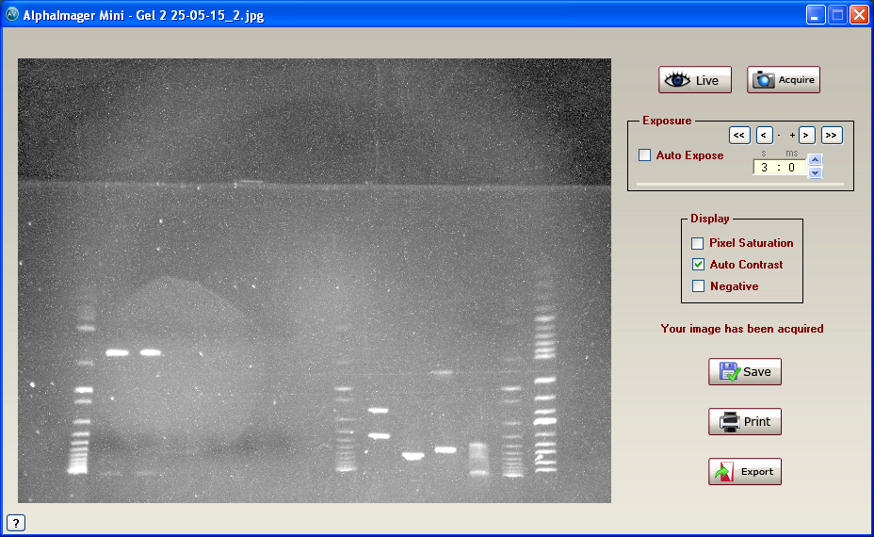

Slide 2
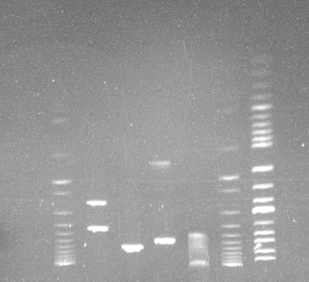
250515 Digest of pCM148
4k
5k
6 kb
8k
10k
marker
H
E
1
P
uncut
Ladder
marker

Slide 3
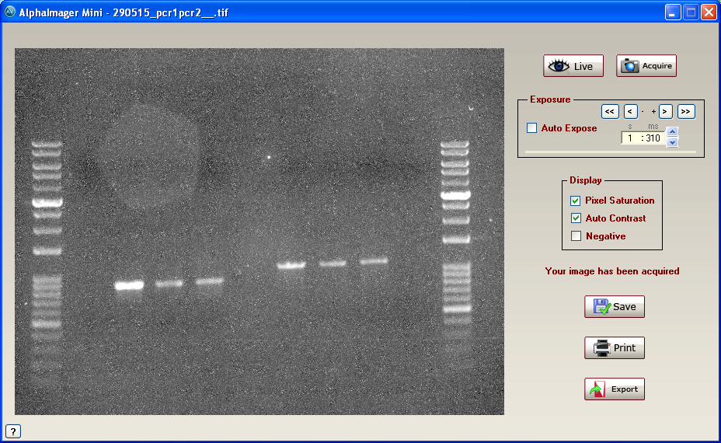

Slide 4
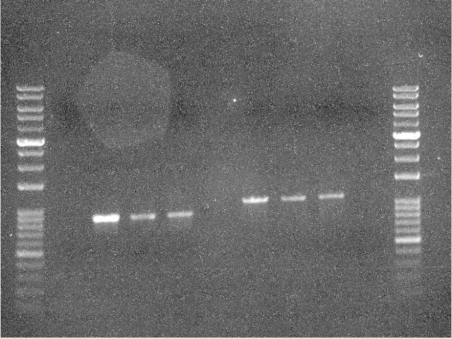
29, Mar 2015 PCR1 PCR2 crp11

Slide 5
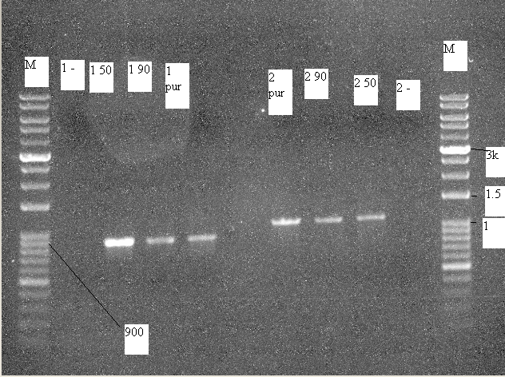
29, Mar 2015 PCR1 PCR2 crp11

